Slide 1
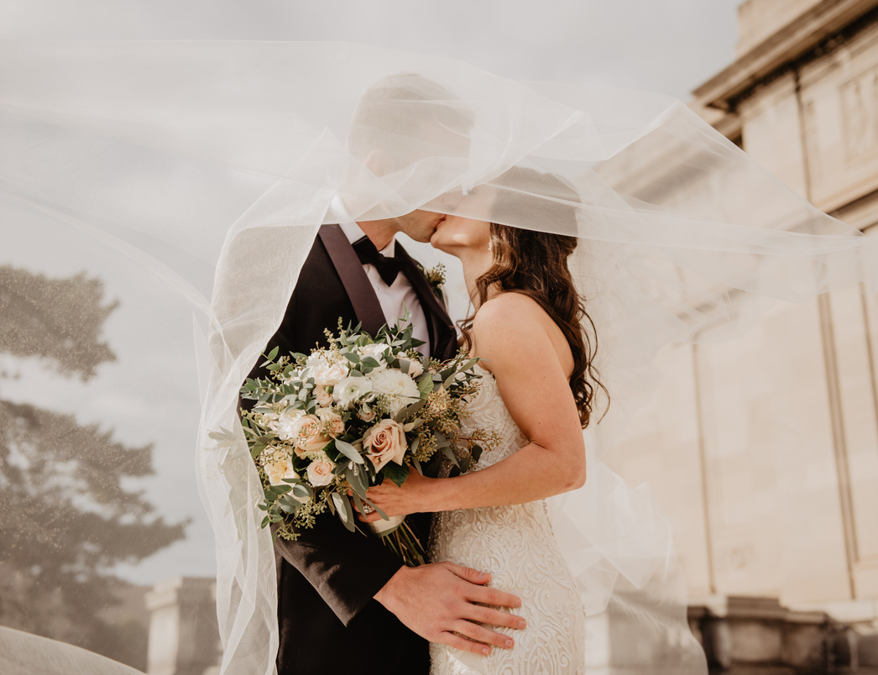


THE WEDDING OF
Olivia &
Richard
SEPTEMBER
SATURDAY
25
AT 2 PM
2022
123 ANYWHERE ST.,
ANY CITY

