Slide 1
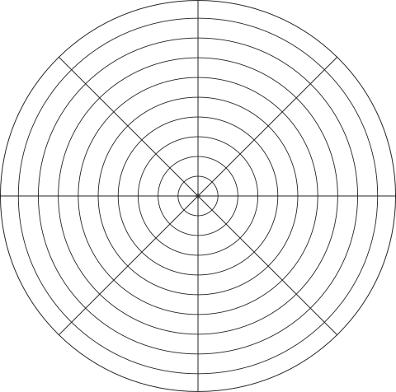
Wheel of Life Balance
THIS VISUAL REPRESENTATION PROMOTES REFLECTION AND ENHANCES UNDERSTANDING OF LIFE'S INTERCONNECTED DOMAINS, SERVING AS A VALUABLE RESOURCE FOR PERSONAL GROWTH AND HOLISTIC WELL-BEING.
finance
self-development
career
health
your option
friendship
leisure
love
Notes

