Slide 1
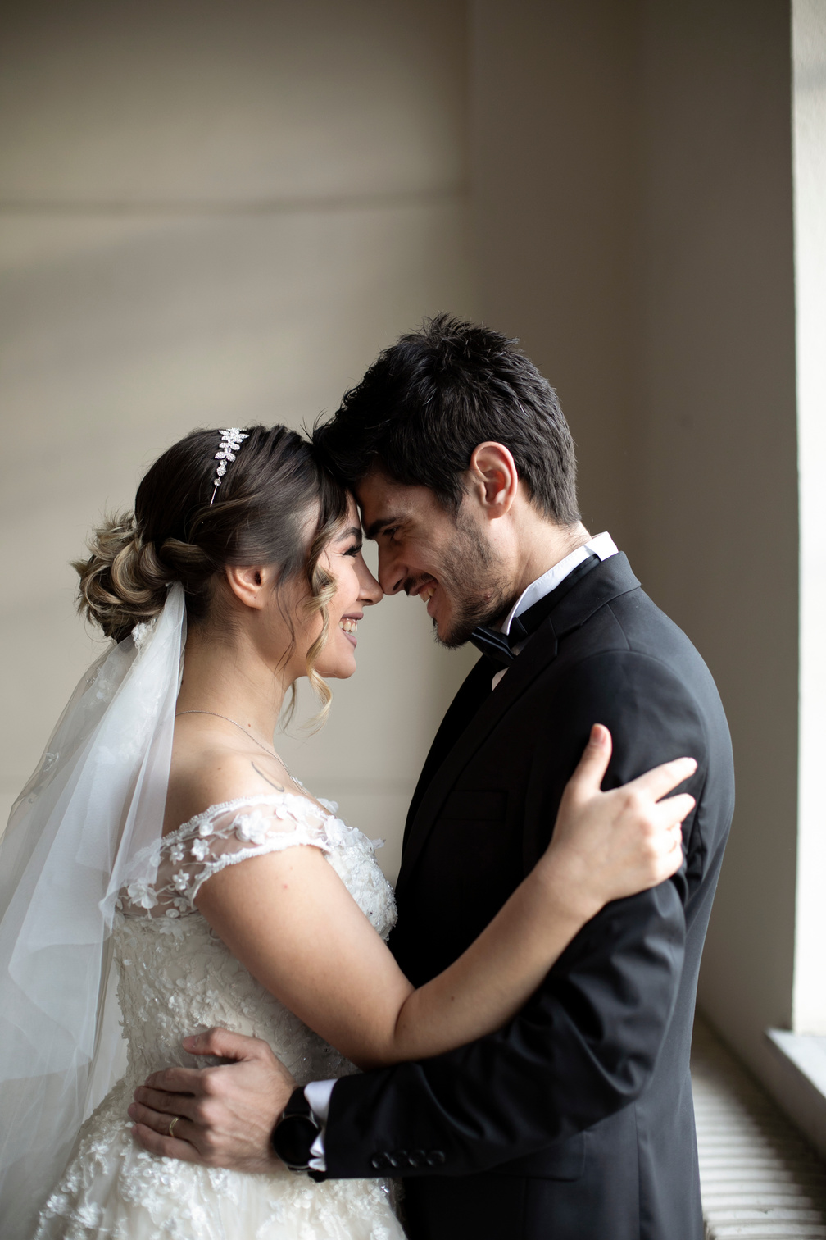

SAVE THE DATE
Adam
&
Christy
We invite you to join our wedding
25
10
23

Slide 2
Adam
&
Christy
Dear family and friends
It was the most beautiful day of our lives and it wouldn't be the same without you! We truly thank you for your generosity and presence on our special day.
For your convenience, we have booked rooms at the following hotels:
Borcelle hotel & resort
123 Anywhere St., Any City
www.reallygreatsite.com

